Slide 1


Authorization
INFORMATION ENCODING STANDARDS
Submission by: GROUP 12

Slide 2
Project Description
Part 1: User data protected by authorization.
Part 2: Security Technologies Recommendations

Slide 3

User data protected by authorization : WebApp
The important parameters for creating an API are included in the project summary, as well as how the API and the system are maintained while maintaining the highest level of security. Data must be authenticated, and Authorization must be checked to ensure that no data is accessed by a third party who does not have access to the same. Because data security is the most significant aspect of data sharing and accessing across many systems, resources, companies, and customers, maintaining information standards is the most important factor.

Slide 4
Security Technologies Recommendations : Security Consultation
Maintaining information standards is the most critical component in data sharing and accessing data across various systems, resources, companies, and customers. The most important aspect of data sharing and accessing data across diverse systems, resources, enterprises, and customers is maintaining information standards. Because data security is the most significant aspect in data sharing and accessing across many systems, resources, companies, and customers, maintaining information standards is the most important factor.

Slide 5
TEAM MEMBERS
TIRTHESH JAIN
200495951
DEVELOPER
BSc. Physics , PGDIP - AI
Skills:
Machine Learning
Deep Learning
RAKSHIT L. WILSON
200489590
- Bach. In Computer Science & Tech
Skills:
-Analytical and Logical Thinking
-Python image segmentation
HRITIKA GUPTA
200523837
- BSc. IT graduate
3 Yrs experience in marketing
Skills:
- Flask
- Python numpy, panadas, matplotlib

Slide 6


Part-1: Demonstration

Slide 7
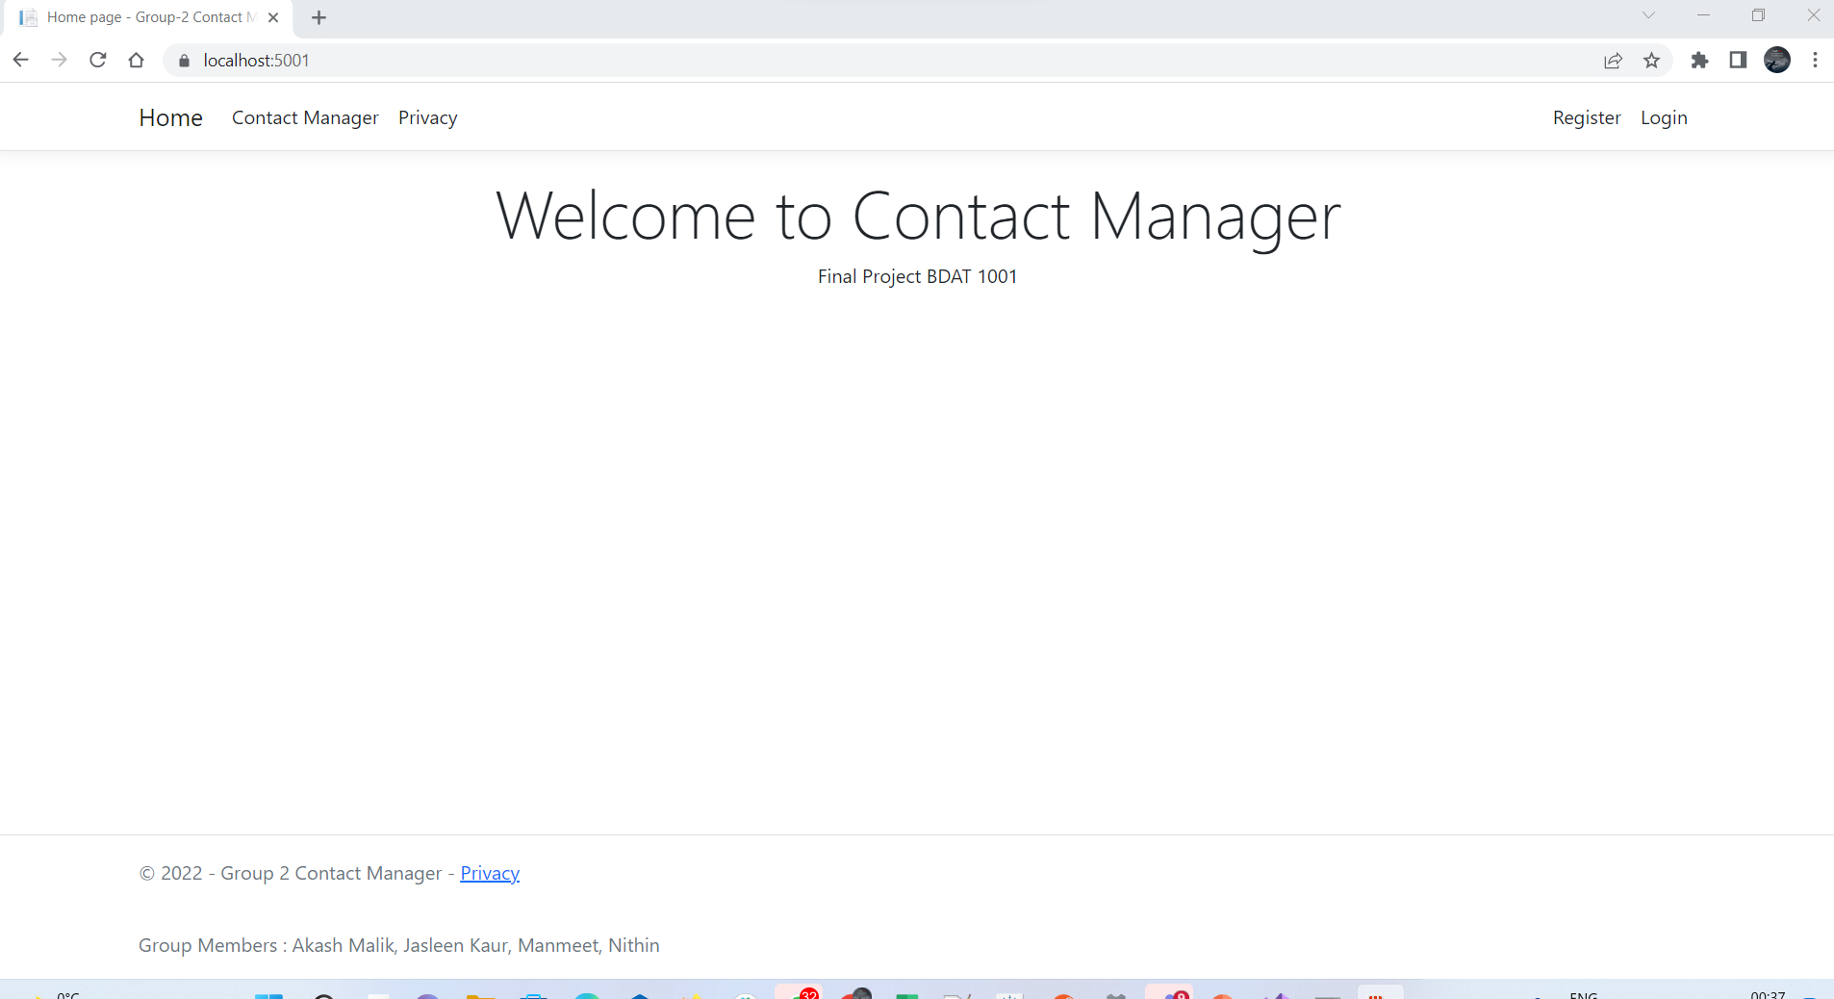
Home Page
Home page with login, register and contact manager options.

Slide 8
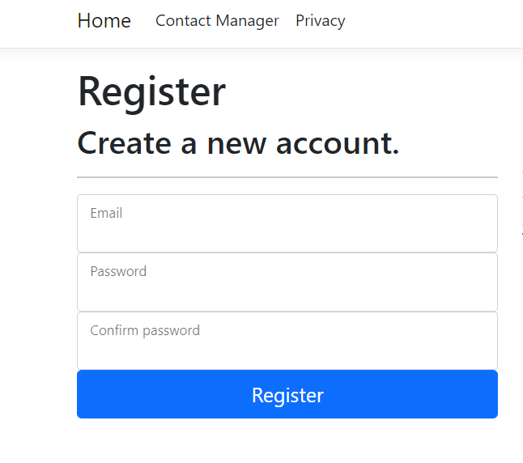
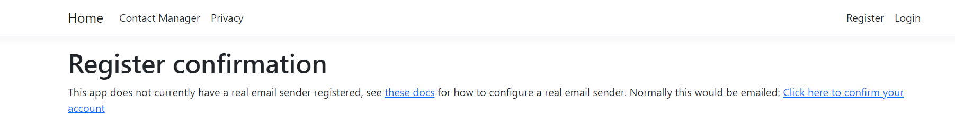
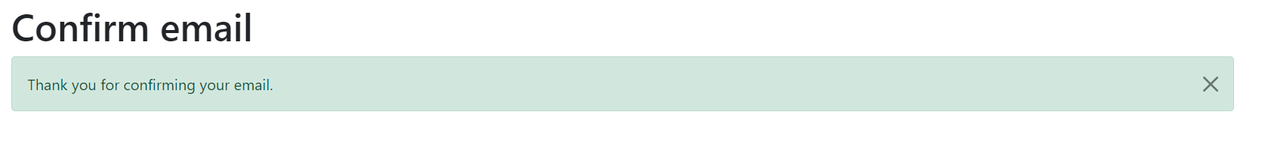
Register
Register page with confirming email

Slide 9
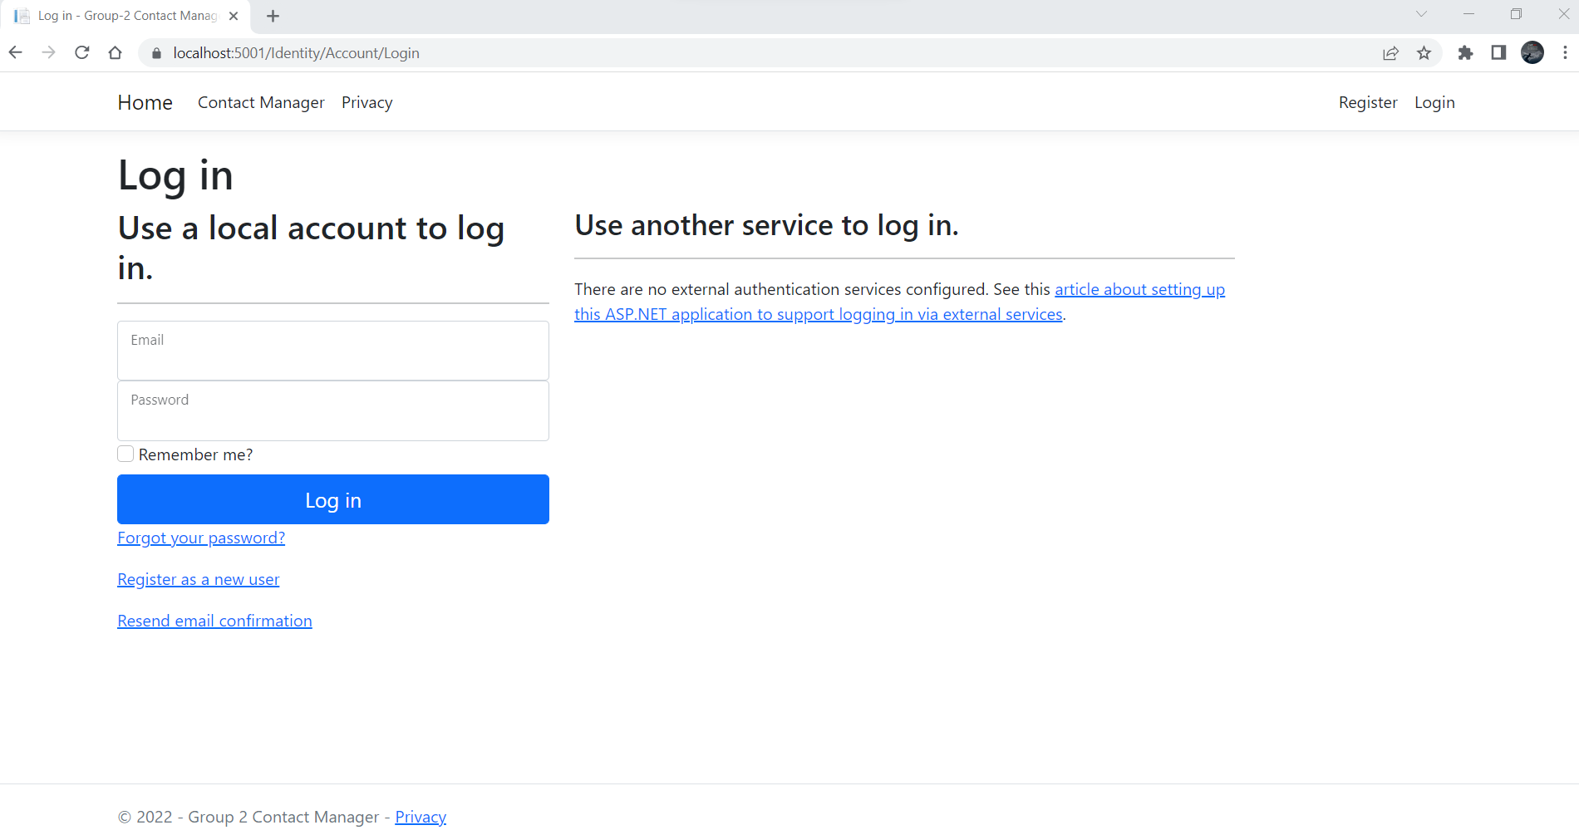
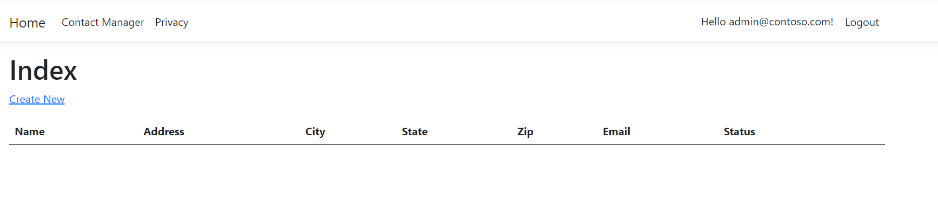
Login
Login with email and Password
Login to Index
Index has logout option

Slide 10
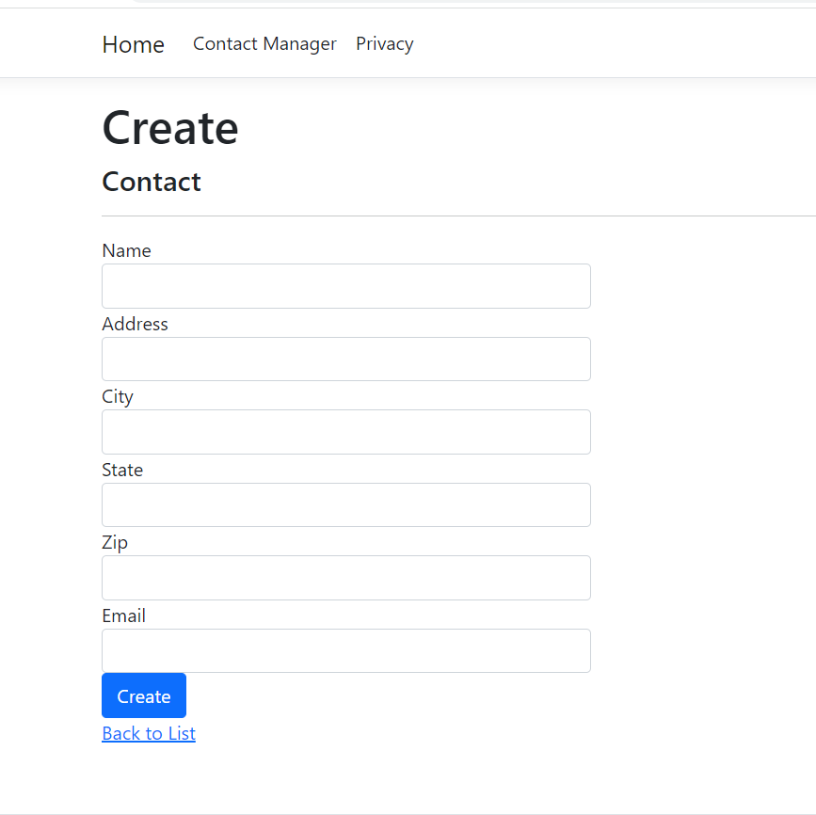
Create User
Contains five fields
Option for back to list

Slide 11
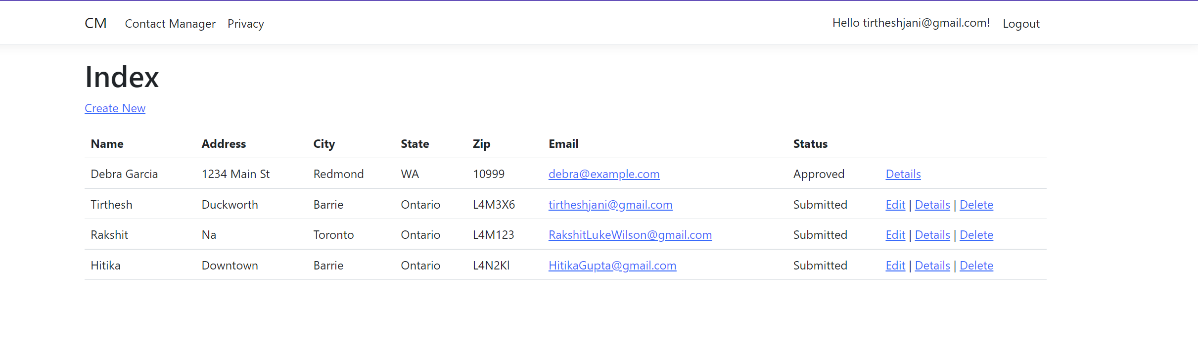
Admin Login
Has options to Edit, Details and Delete
Logout option at top

Slide 12
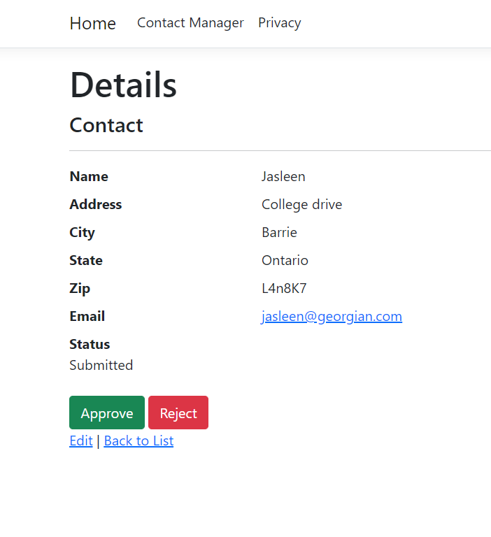
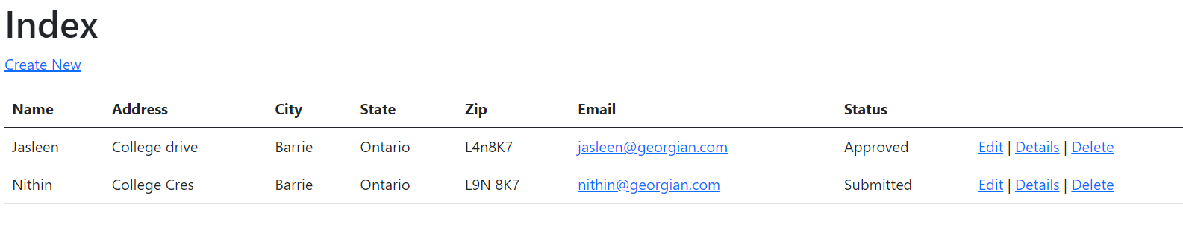
Admin Roles
Admin has approve and reject options.

Slide 13
Manager Login

Slide 14
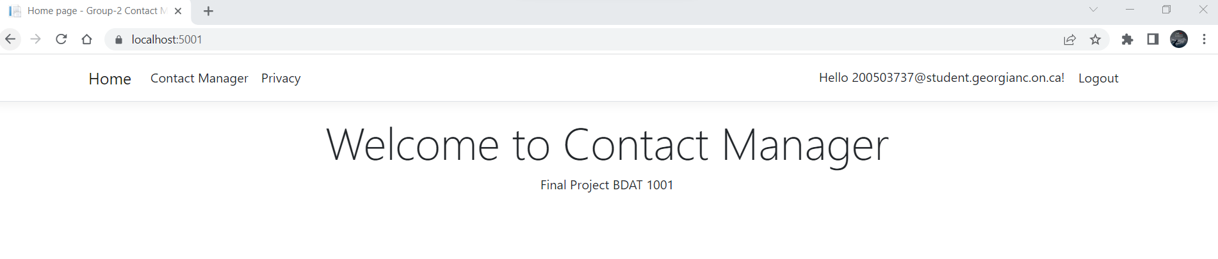
User Login

Slide 15
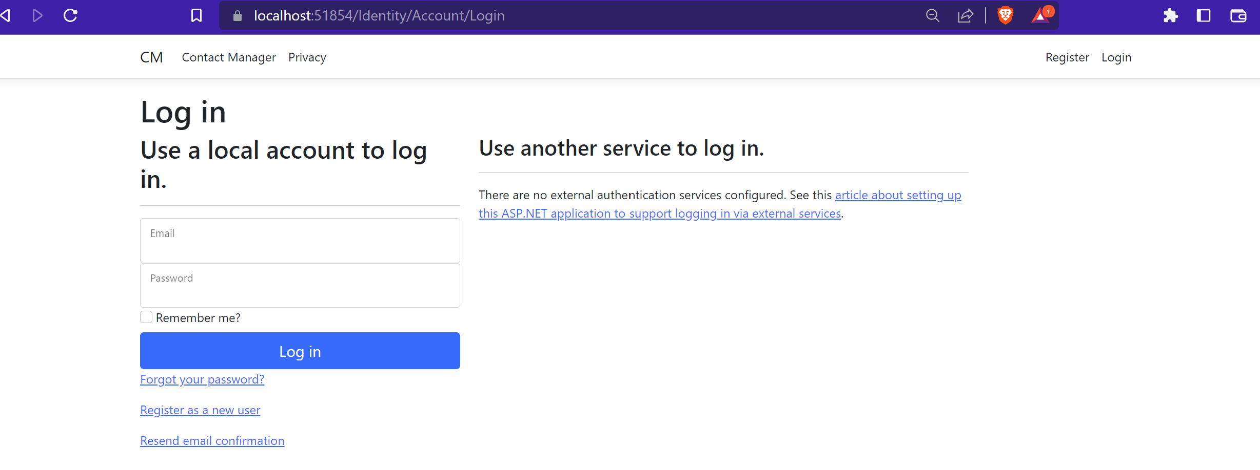
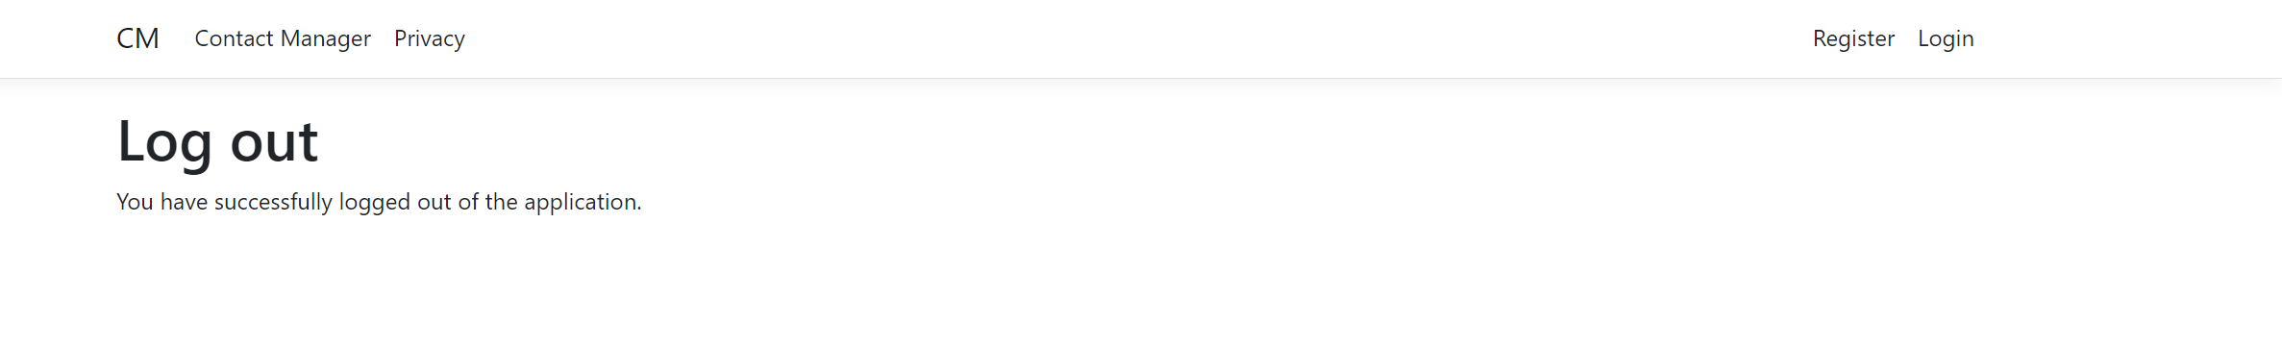

Slide 16


Part-2: Security Technologies Recommendations

Slide 17
How can we transfer personal data securely within their network?
The web permits us to move data in a blink of an eye. You can send online nearly anything you need, anyplace you really want. However, if you need to ensure your exchange is protected, you need to know how to get it.
The SSH(Secure Socket Shell) protocol uses industry-standard strong encryption algorithms, like AES, to secure the communication between the involved parties. In addition, the protocol uses hashing algorithms, such as SHA-2, to ensure the integrity of the data transmitted.

Slide 18
What security protocol is best for transferring personal files?
In extension to SSH, SFTP can be handy in all situations where sensitive data needs to be protected. For example, proprietary data and intellectual property (IP) may not be covered by any particular data privacy rule, but it can be devastating to fall into the wrong hands. An organization might use SFTP to transmit files containing trade secrets or other similar information.
Speed: The servers used with SFTP can easily support large file transfers, as well as transferring multiple files at once, saving time when moving data from one server to another.
Security: Thanks to encryption, public key authentication, and data security, SFTP can preserve the confidentiality and integrity of your data
Manageability: SFTP gives you the ability to easily manage your server using a web interface or an SFTP client.
Integration: SFTP and firewalls go hand in hand. Data, commands, and sensitive information are all sent over a single connection to Port 22, which is by default enabled with firewalls in their security parameters.

Slide 19
Can we encode and encrypt images?
An image can be encoded and encrypted by using encryption algorithms or third-party software.
ESP(Easy Secure Photos) employs an image encryption algorithm whose resulting files can be compressed and still get recognized as images, albeit ones that look like black and white static to anyone except authorized users. In addition, ESP works for both lossy and lossless image formats such as JPEG and PNG and is efficient enough for use on mobile devices. Encrypting each image results in three black-and-white files, each one encoding details about the original image's red, green, or blue data.
Image -> Encrypt -> B64Encode -> SaveFile
ReadFile -> B64Decode -> Decrypt -> Image

Slide 20
Our database cannot be moved from the site, and we need to be able to access it externally using a secure API. Can you explain the architecture of a secure API?
As we are working on a web application and we have to fetch data from the site, We can build an external REST API.
A REST API (also known as RESTful API) is an application programming interface (API or web API) that conforms to the constraints of REST architectural style and allows for interaction with RESTful web services.
API Architecture:
Information Management Layer
Application Layer
Integration Layer
Interaction Layer

Slide 21
Can you recommend a secure framework for coding an API?
ASP.Net Core & Django are the frameworks for coding secure APIs. Depending on the architecture of the application we can choose one among these. Both use a strong encryption algorithm to prevent XSS attacks.
Django is the web framework for choice for most Python users. Django’s website lists speed, scalability, and security as its main features.
ASP.NET Core is the newest kid on the block. Recently released by Microsoft, ASP.NET Core looks to bring .NET development into the future by providing a cross-platform, high-performance, open-source framework for building cloud-first web applications.

Slide 22
What data interchange format should we use while transferring data between locations?
Java Script Object Notation(JSON) is a data-interchange format that can be used to transfer data between locations.
JavaScript Object Notation is a schema-less, text-based representation of structured data that is based on key-value pairs and ordered lists. Although JSON is derived from JavaScript, it is supported either natively or through libraries in most major programming languages. JSON is commonly, but not exclusively, used to exchange information between web clients and web servers.
JSON is a file format that uses human-readable text for storing and transmitting data objects containing attribute-value pairs and arrays.
Unlike XML, The write and parse operation is easy in JSON.

Slide 23
How should we store our data in our many locations?
Maintaining the data in multiple locations is crucial and advisable in every term. There are a few options where the data can be kept securely:
Cloud Storage: Cloud storage is simply offsite computing that holds your data for you to access anytime, anywhere.
Server Based: Server-based or hyper-convergence storage is data stored within individual servers at a data center, typically on your business site. Businesses with the budget for it can appreciate their speed and in-house control. With hyper-convergence, you have different servers, and your data is striped across them.
Traditional Storage Systems: Traditional storage is commonly used as a backup method for the cloud. Where we can keep meta data.
The data should follow a database management system and uses the same schema for easy operations.

Slide 24
What are the ethical concerns related to the transmission of personal data?
PI can only be used with consent.
Unauthorized access to private data.
Misuse of PI(Personal Information).
Accuracy & Retention
Integrity
Availability
.

Slide 25
Appendix
Special Thanks to Professor Nital Shah for providing her guidance.
https://docs.microsoft.com/en-us/aspnet/core/security/authorization/secure-data?view=aspnetcore-6.0
https://www.youtube.com/watch?v=TDY_DtTEkes
https://www.akana.com/blog/api-architecture
https://gc.blackboard.com/webapps/blackboard/content/listContent.jsp?course_id=_330619_1&content_id=_7006505_1

Slide 26
Thanks!

